Slide 1
ANALYZING SPORTS ACROSS THE U.S.
KATHRYN DAVIS, JORGE TORRES, FERDJELLAH AGRI, AND SIBEYI TSHIFHIWA

Slide 2
PROJECT OVERVIEW
We wanted to analyze sports popularity and participation along with ticket prices and salary. We did so by:
Web scraping and data extraction from a webpage
Analysis of sports participation statistics from a CSV file
Calculation of top sports participation statistics for boys and girls per state

Slide 3
PREDICTIONS
We predicted that the more money a state put into a sport and made off of said sport, the more popular that sport would prove to be.

Slide 4
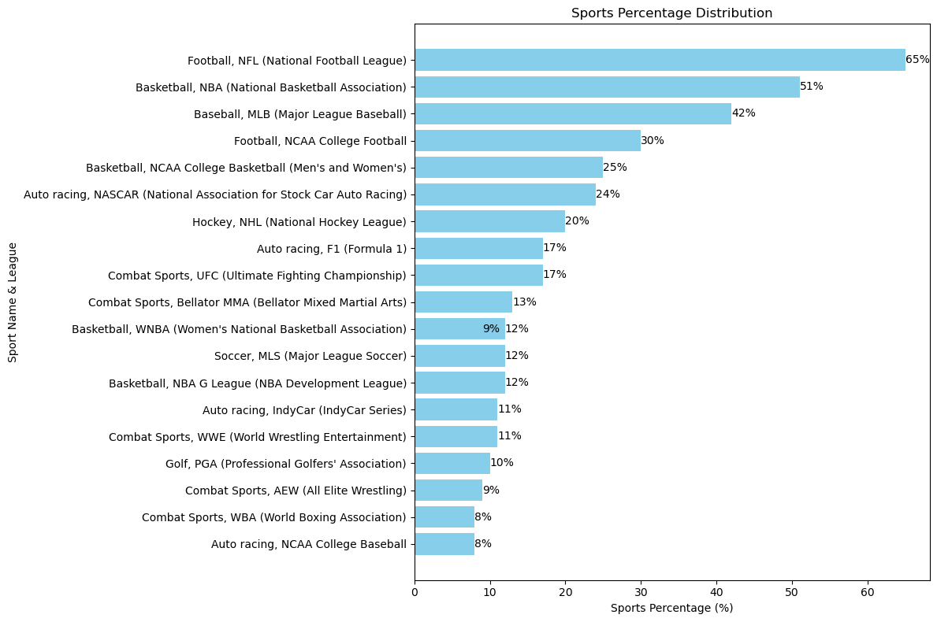
The most popular U.S. sports leagues to watch

Slide 5
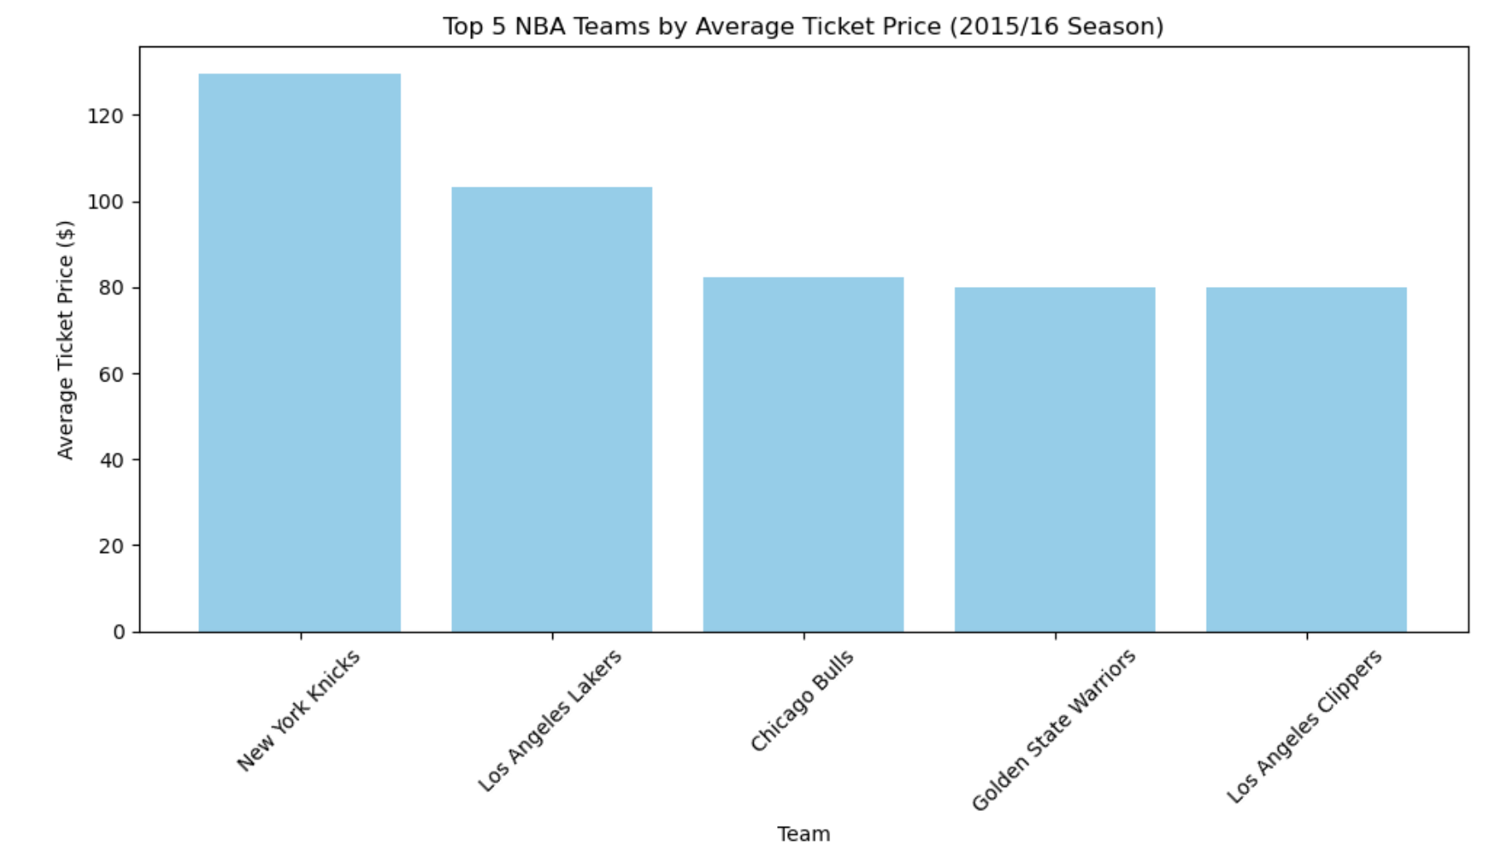
NBA Ticket Prices

Slide 6
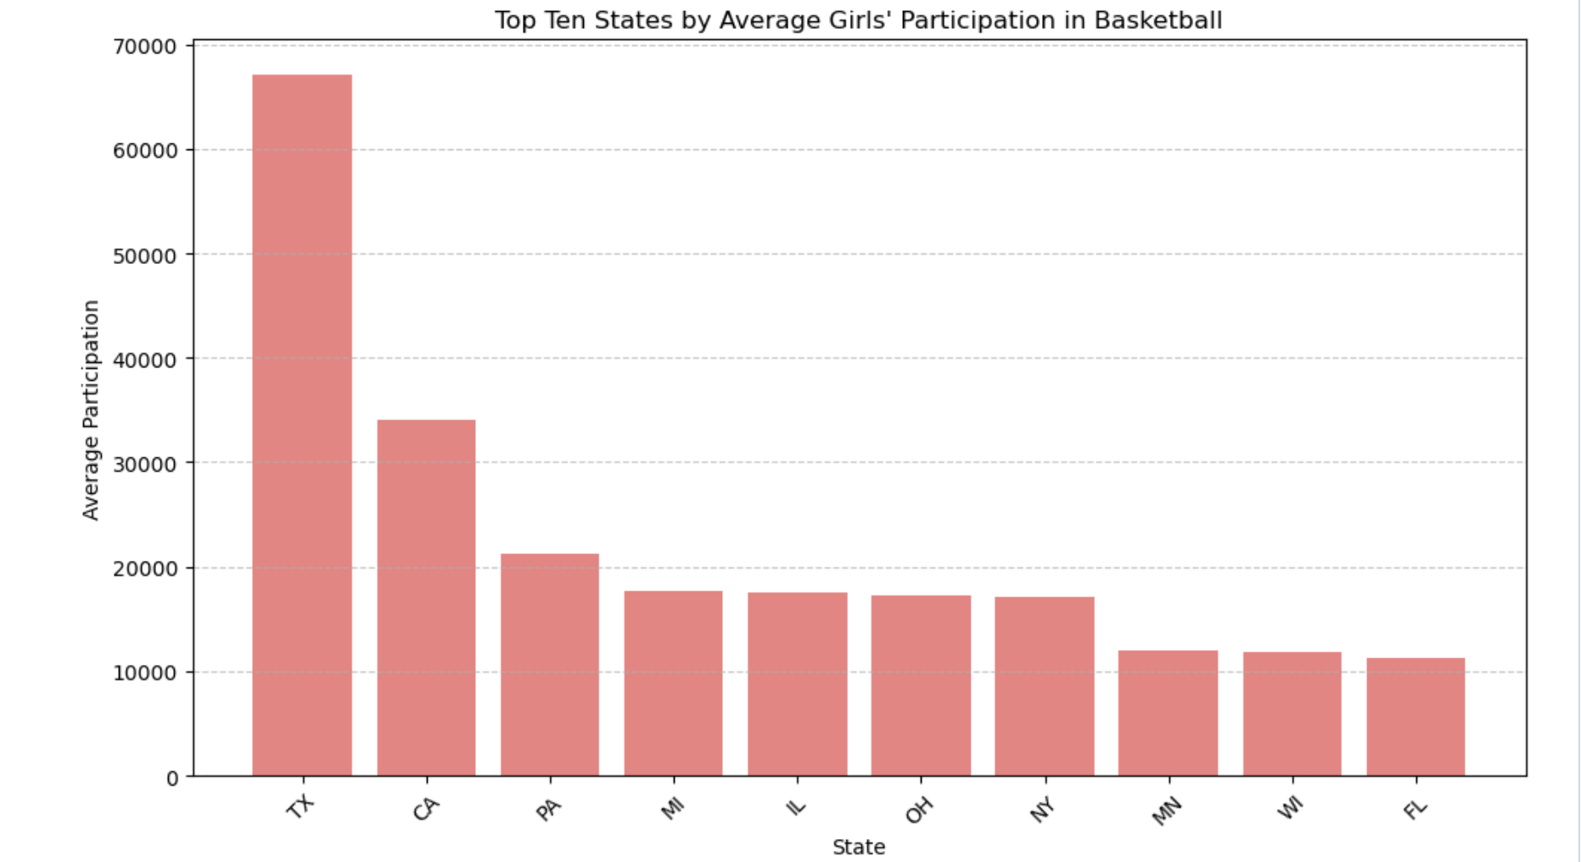
GIRLS BASKETBALL PARTICIPATION

Slide 7
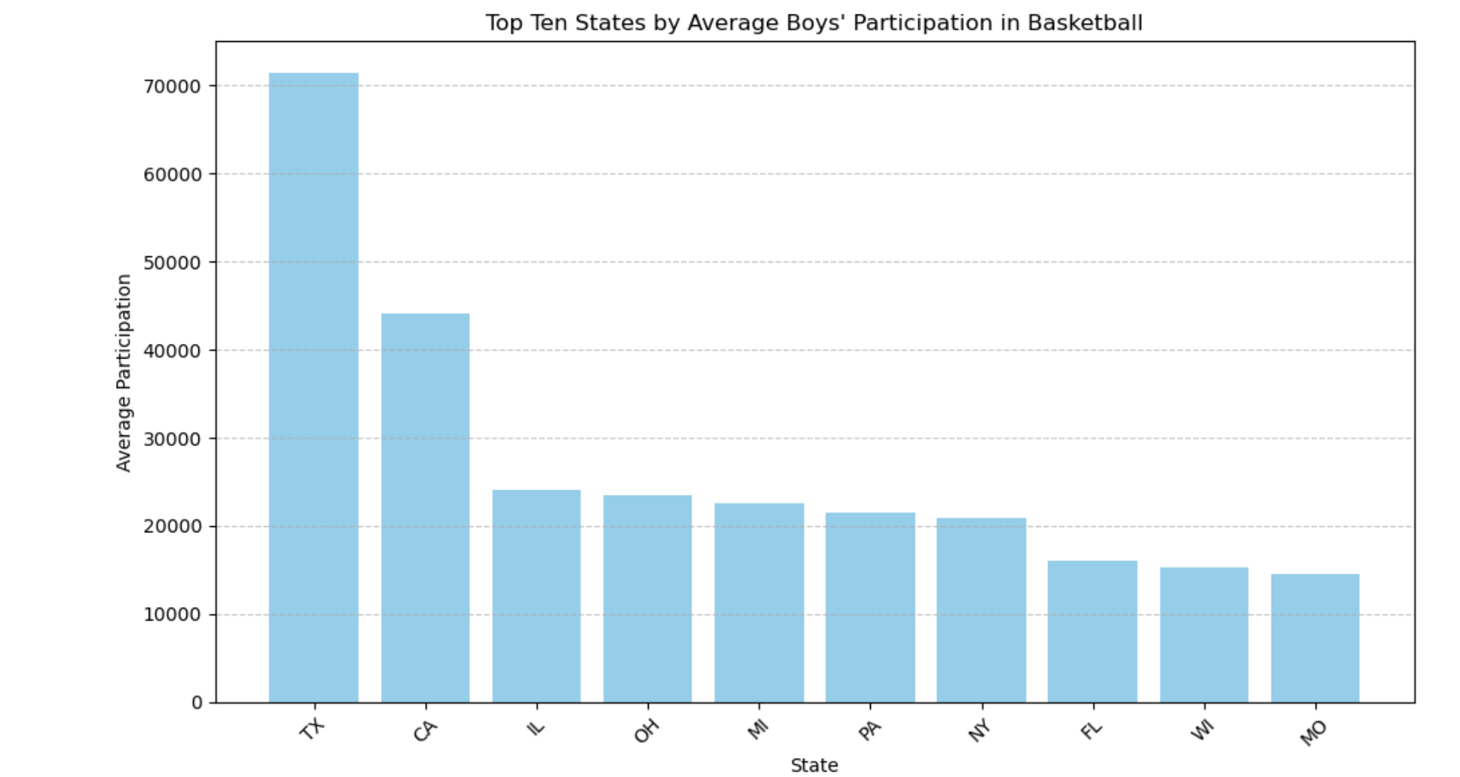
BOYS BASKETBALL PARTICIPATION

Slide 8
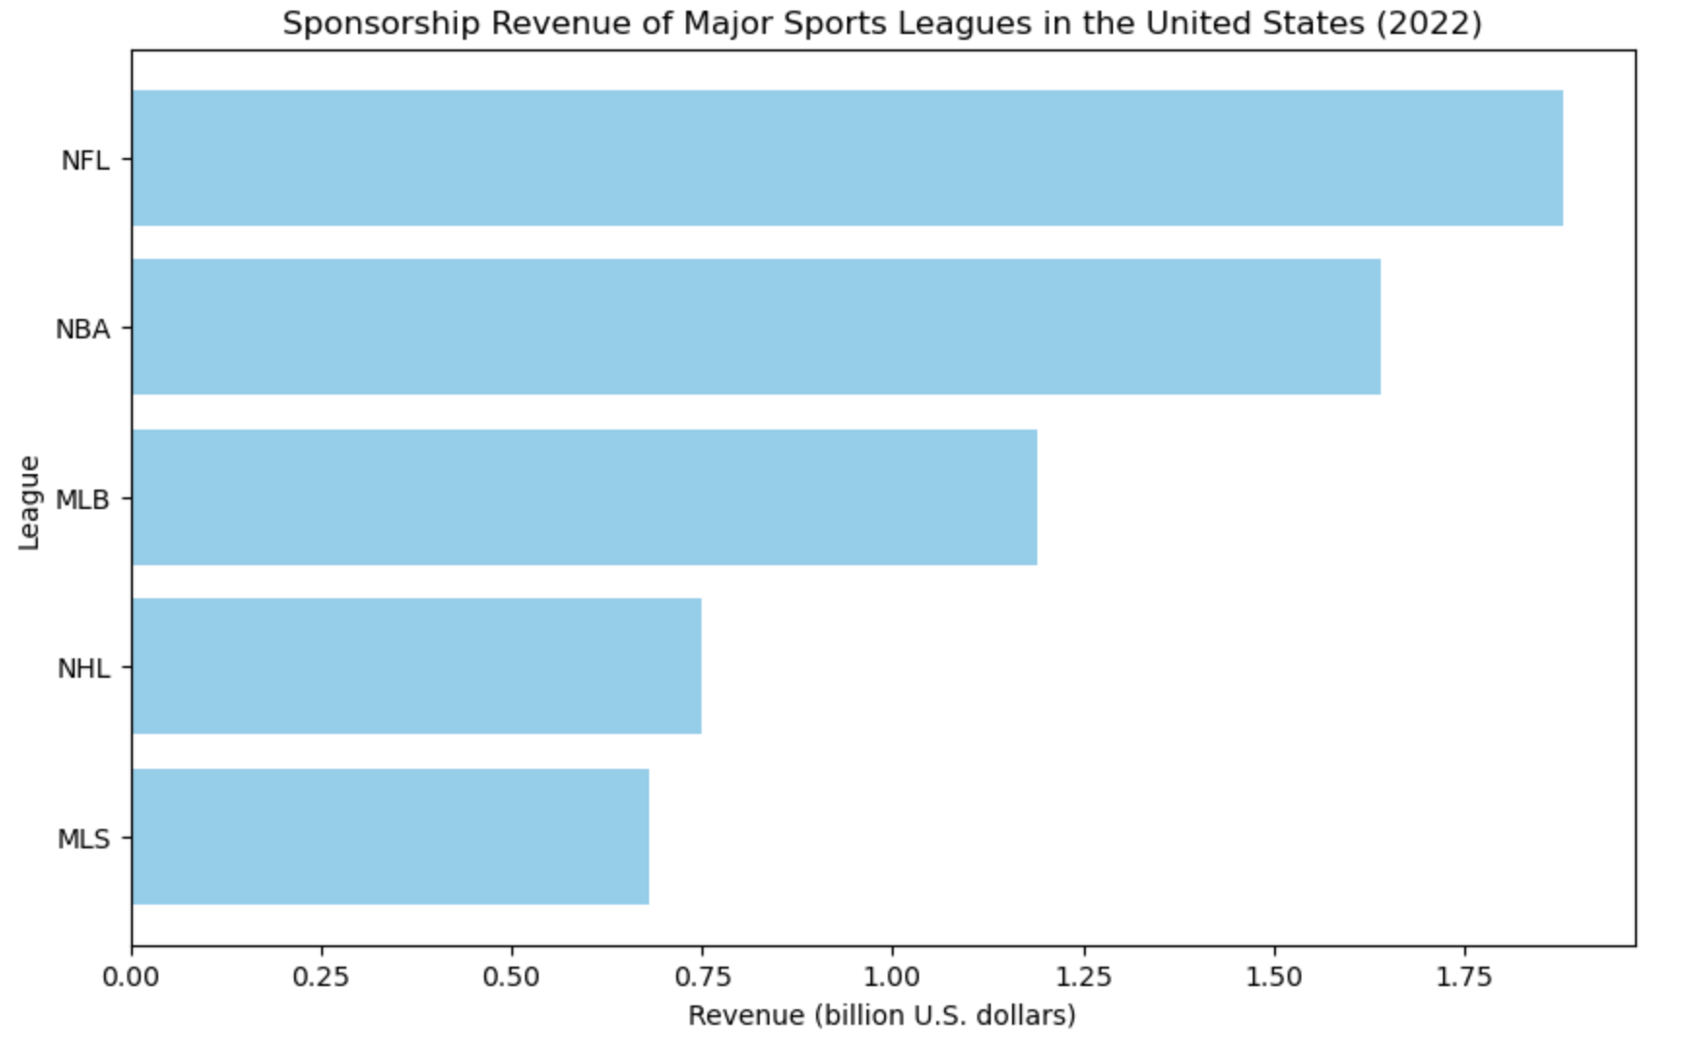
Sponsorship Revenue & Sports Popularity

Slide 9
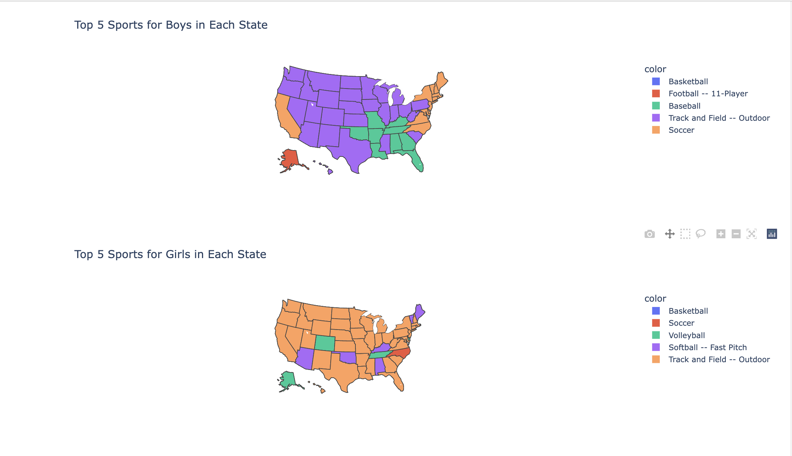
Top 5 sports in each state Boys and Girls

Slide 10
Top Sport in each state
../project3/sports_map1.html

Slide 11
ETHICAL CONSIDERATIONS
Consent and Privacy:
Ensure that the data we scraped did not include personally identifiable information.
Purpose and Use of Data:
Be clear about the purpose of our project and how the data will be used.
Ensure that the data was used in a way that benefits the community and does not cause harm.

Slide 12
CONCLUSIONS
We predicted that the more a state put into a sport and made off of a sport, the more popular that sport would prove to be. However, we found that not to be the case. This left room for future directions, though. We hypothesize that population and cost of living may have more of an impact on how popular a sport is, actually.

